Slide 1
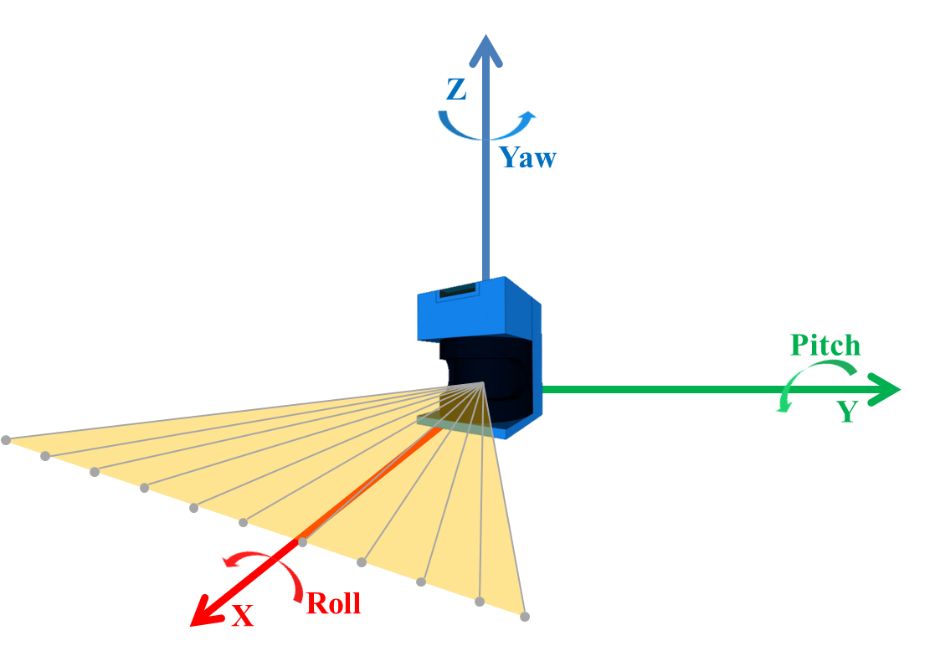
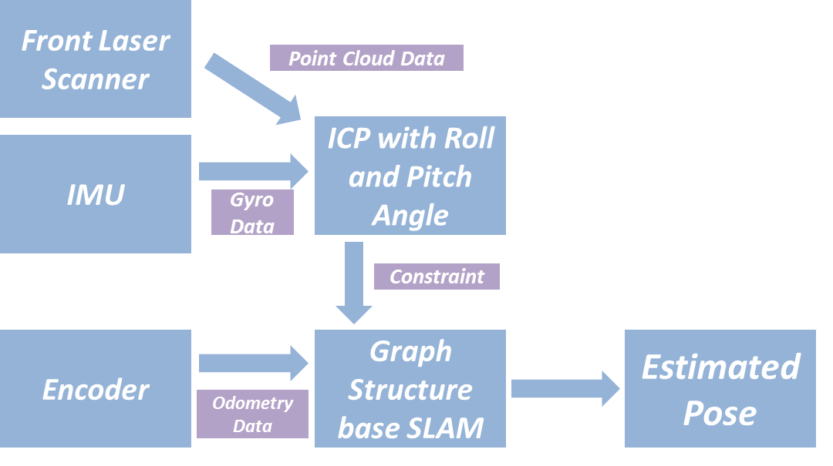
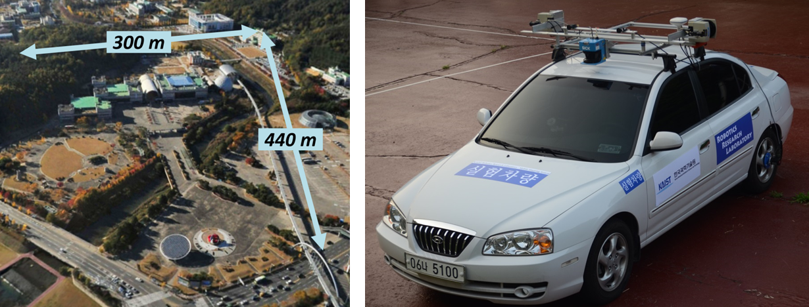
Hedonic Game for Task Allocation in Heterogeneous Multi-Robot Systems
Kim, Hyeongseop; Jang, Inmo; Oh, Hyondong (UNIST, Korea, South)
Objective
  mobile robot localization in out door environments, such as an uneven terrain
PROPOSED WIDEBAND PA
ICP with Roll and Pitch Angle
    ICP Algorithm considered the roll and pitch angles of laser scanner (Fig. 2.)
    Better performance in uneven outdoor environments
  Constraint of Graph Structure
    Constraint for graph structure based SLAM
    Valid constraints from the ICP algorithm
    Wheeled robot kinematics (In comparison with odometry, if the translation of the ICP result is too small or too large, it was also considered an invalid constraint.)
Experiments
  Experimental Setup
    Experimental environment size (300m x 440m)
    Sensor system (IMU, laser scanner, wheel encoder) (Fig. 3.)
    GTSAM (Matlab platform based open source)
  Results
    The results of ICP without any preprocessing and ICP with the pre-processing considering roll and pitch angles (Fig. 4.)
    The overall SLAM results (Fig. 5.)
    Enlarged figure in section A and B of Fig. 5. (Fig. 6 and Fig. 7)
Fig. 1. The overview of the localization algorithm
Fig. 2. The axis of the laser scanner
Fig. 3. Experimental setup (left) experimental environment, (right) sensor system
B
A
Fig. 5. Experiment results
Fig. 6. Section A of Fig. 5

